Slide 1
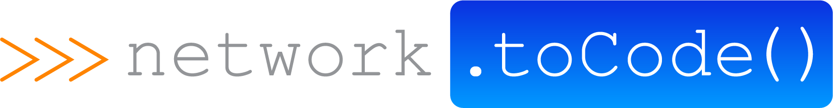
Arista ATD with Ansible Tower

Slide 2
Network to Code Services Offerings
Workflow Automation & Optimization
Software Development
Training / Workshops
Review Network Operations Workflows
Python for Network Engineers
DevOps Tools
Network Device APIs
Private/Public Courses
Custom network Applications
DevOps Tool Plug-Ins & Integrations
Helps Eliminate repetitive tasks
Optimize
Drive Down operational inefficiencies
Bootcamps
Ansible for Network Engineers

Slide 3
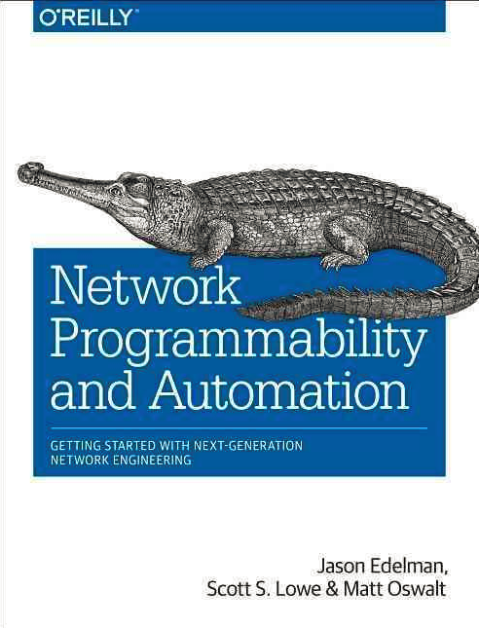
Win a FREE Network Automation Book!
Drop off a business card
Have the chance to win Network Programmability and Automation

Slide 4
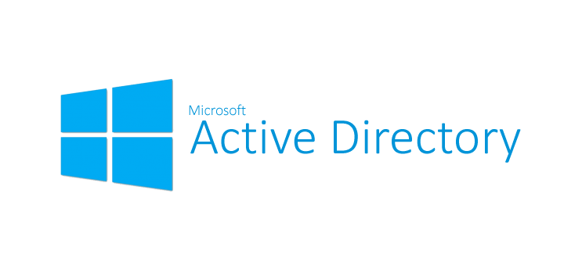
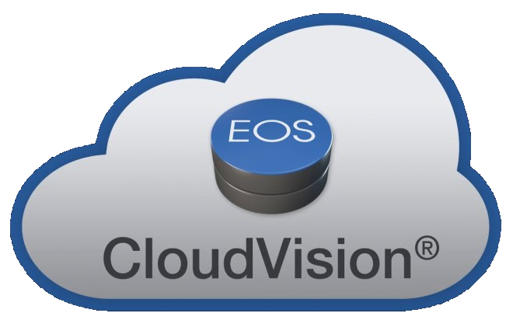

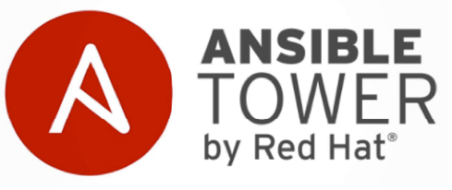



Arista ATD Integration Components

Slide 5


Leaf - Spine Topology
eBGP used both within the underlay and overlay
iBGP between MLAG peers
Hosts are dual connected
Host 1 in Vlan13
Host 2 in Vlan12
Host 3 in Vlan13
Host 4 in Vlan12
Looking for Layer2 reachability across VXLAN/EVPN fabric
AS
101.0
.1
eBGP
172.16.1.0/30
eBGP
172.16.2.0/30
AS
101.1
AS
101.2
.2
iBGP
VARP
MLAG
Host1
- Vlan 13
- 10.11.13.11/24
Host2
- Vlan 12
- 10.11.12.12/24
Host3
- Vlan 13
- 10.11.13.13/24
Host4
- Vlan 12
- 10.11.12.14/24

Slide 6
Network to Code At A Glance
WHAT WE DO
Network to Code provides high value services, training, and development in the network programmability and automation space.
WE BRIDGE THE GAP BETWEEN DEVOPS AND NETWORK ENGINEERING

Slide 7
Network Automation with Ansible Tower Demos
Integrations with ServiceNow, Slack and NetBox
Auto-Configure network from NetBox webhooks
Validate compliance from Slack
Obtain Facts from network devices via Slack
Configure FW policy from ServiceNow & Slack
Upgrade network OS from Slack and ServiceNow
Integrate Ansible dynamic inventory with NetBox
Configure ports from ServiceNow or Slack
Real-time notification of configuration changes

